Slide 1
MATLAB®
An Introduction

Slide 2
What is MATLAB®?
MATLAB® /Simulink® is a powerful software tool for:
Performing mathematical computations and signal processing
Analyzing and visualizing data (excellent graphics tools)
Modeling physical systems and phenomena
Testing engineering designs

Slide 3
Industry Applications
Aircraft/Defense: control and guidance system design and simulation, communications
Robotics: design and control
Automotive: cruise control, stability enhancement, fuel injection systems, hybrid power-train, sound suppression …
Communications: voice over internet, cell-phone, satellite, antenna design, wireless, error coding …
Biotech, Pharmaceutical, Medical: drug discovery and development, imaging procedures, cancer diagnosis …

Slide 4
Industry Applications (con’t)
Electronics: chip design, acoustics, voice processing and recognition
Industrial Automation and Machinery: sensor design, machinery design and control
Utilities and Energy: power conversion and control
Computers: security systems, printer design
Financial: portfolio management and risk, commodity trading, currency markets

Slide 5
MATLAB® Desktop

Slide 6
MATLAB Desktop
The Command window is where you type MATLAB commands following the prompt: EDU>>
The Workspace window shows all the variables you have defined in your current session. Variables can actually be manipulated within the workspace window.
The Command History window displays all the MATLAB commands you have used recently – even includes some past sessions.
The Current Folder window displays all the files in whatever folder you select to be current.

Slide 7
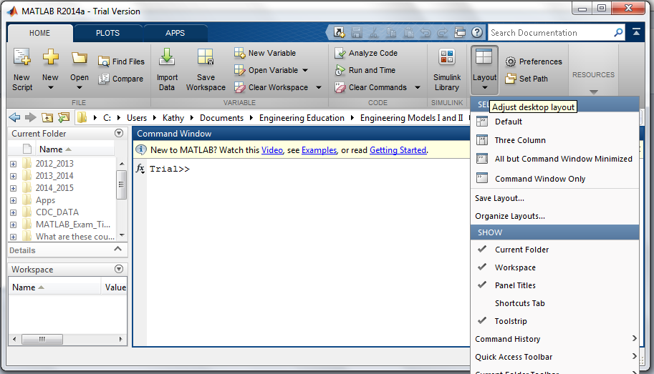
MATLAB Desktop
You can select what is on your desktop by Clicking on Layout. Go down to Command History and select docked.

Slide 8
Using MATLAB® As a Calculator

Slide 9
Arithmetic Operators and Order of Operations
Addition (+), Subtraction (-), Multiplication (*), Division (/), Power (^)
Order of Operations (same rules you should already know from math class and using a calculator)
1. Complete all calculations inside parenthesis or
brackets using the precedent rules below
2. Powers (left to right)
3. Multiplication and Division (left to right)
4. Addition and Subtraction (left to right)

Slide 10
Arithmetic Operators and Order of Operations
Some Examples:
EDU>> 10/5*2
EDU>> 5*2^3+4(2)
EDU>> -1^4
EDU>> 8^1/3

Slide 11
Exercise 1
Calculate the area and circumference of a circle with a radius of 4 cm.
Area = 50.27 cm²
Circumference = 25.13 cm

